Slide 1
Micro Cognitive Radio Network Testbed (MICRONET) for education, experimentation, and demonstration
Eric Sollenberger
Vuk Marojevic
Carl Dietrich
Sponsored by wireless@vt
Virginia Tech

Slide 2
Outline
Motivation
Implementation
Initial experimentation
Limitations
Additional plans
Conclusion

Slide 3
Micronet: Motivation
Testbed Design Goals
Inexpensive
User friendly
Portable
Multiple node support
Price ($)
>$100k
$10k-$100k
$1k-$10k
>60
$100-$1k
Radio Nodes
20-60
5-20
Bandwidth (MHz)
1-5
<$100
50-100
<1
25-50
<5
5-25
1
<1
Handheld
CORNET
1-2.5
Desk
Micronet
2.5-6
Room
6-30
Building
Maximum Frequency (GHz)
>30
City
Size

Slide 4
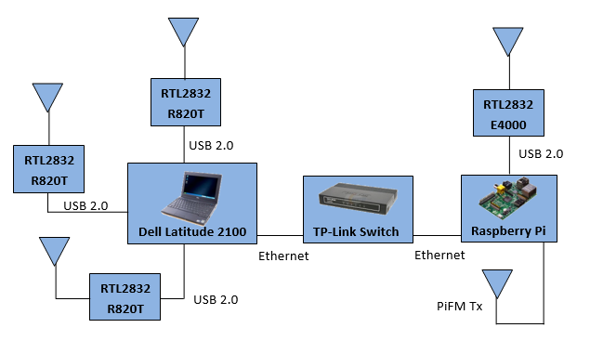
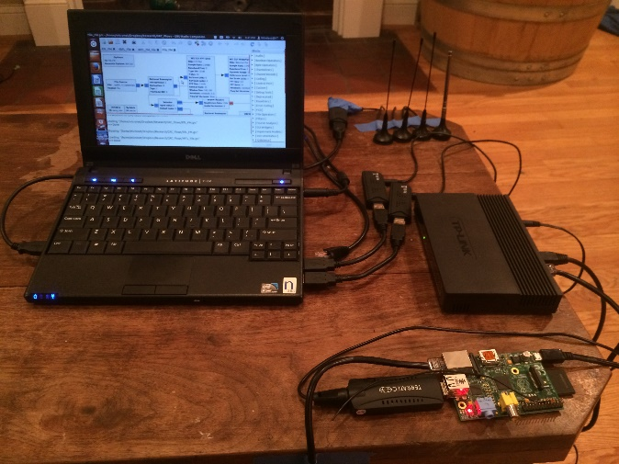
Micronet: Hardware
Block Diagram
Item | Qty | Supplier
Dell Latitude 2100 | 1 | Ebay (used)
Raspberry Pi | 1 | Newark
RTL2832 R820T | 3 | Ebay
RTL2832 E4000 | 1 | Ebay
8 Gb SD Card | 1 | Best Buy
10’ USB Extension | 3 | Sweetwater
Micro USB power cable | 1 | MCM Electronics
Ethernet cable | 2 | Rakuten.com
TP-Link Ethernet Switch | 1 | Newegg
Bill of Materials
Photo

Slide 5
Micronet: The Raspberry Pi as a Transmitter
PiFM
C++ code
Tx frequency range: 1 - 250 MHz
Approximate Tx distance: 100 m
Reads .wav files
Added functionality
FSK/OOK modulation

Slide 6
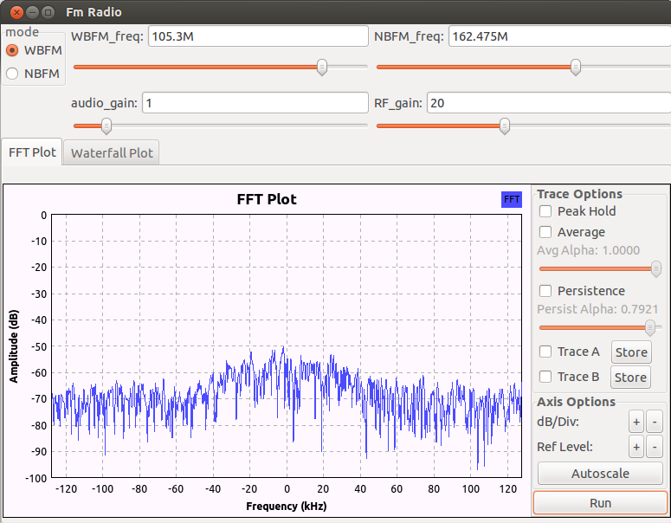
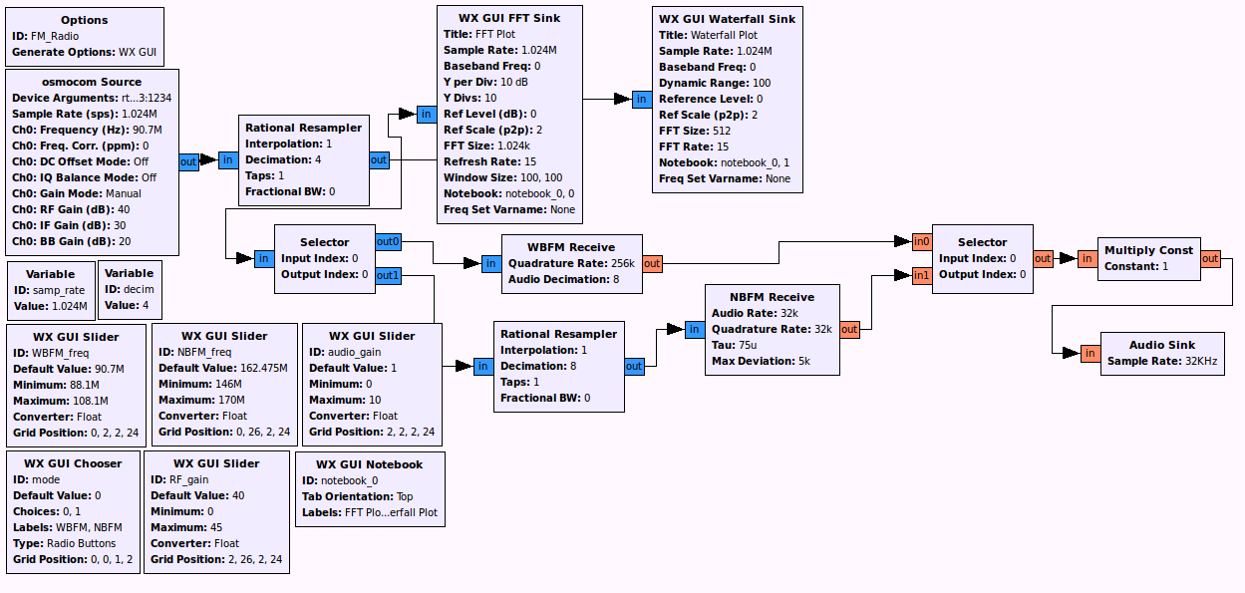
Micronet: Software
Installed Packages:
GNU Radio
liquid-dsp
Pyrtlsdr
RTLSDR Scanner
kalibrate-rtl
XRDP
GNU Radio : FFT plot
GNU Radio Companion: FM Receiver Flowgraph

Slide 7
Micronet: Sample Experiments
FM demodulation/mixer
Raw sample file writes
Spectrum sensing
Antenna diversity
FSK/OOK
Basic DSA

Slide 8
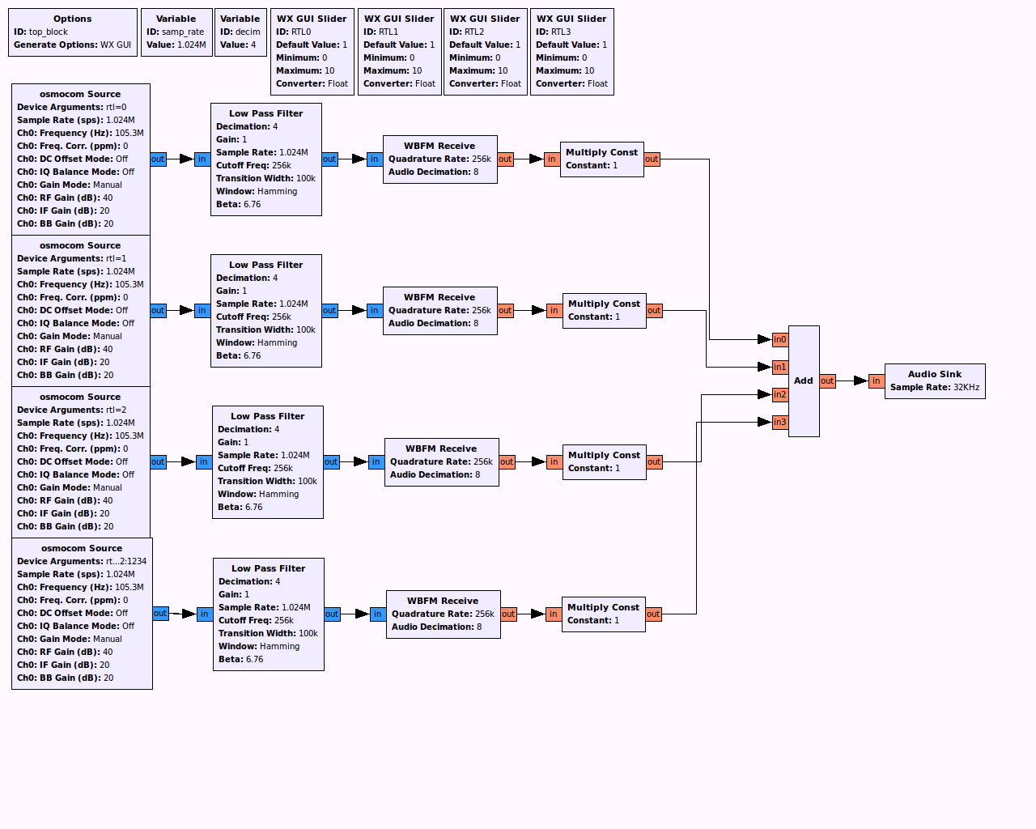
Micronet: FM Mixer

Slide 9
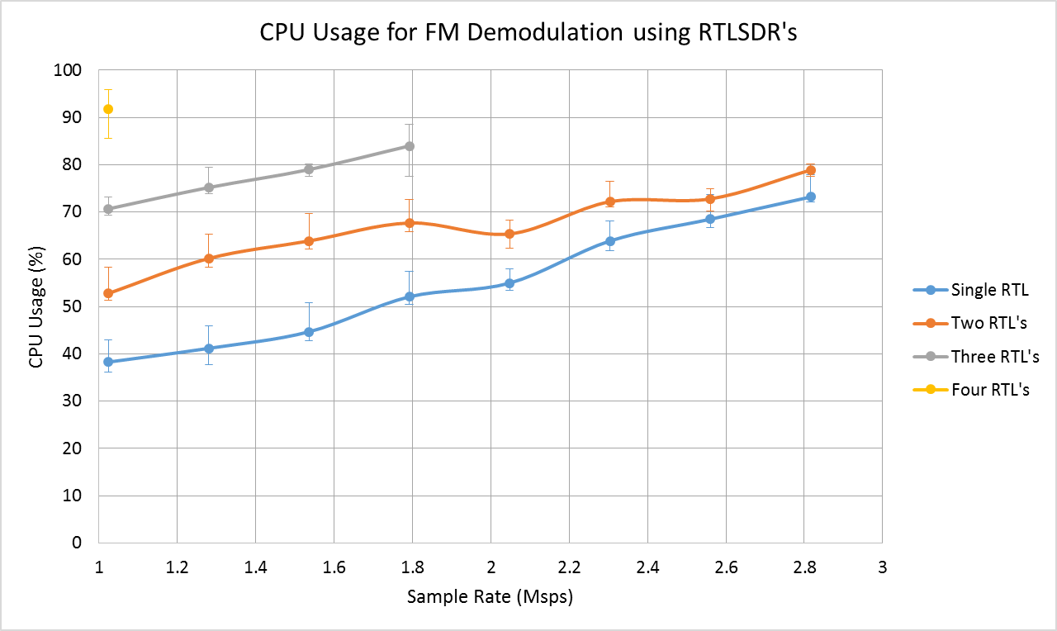
Micronet: FM Mixer

Slide 10
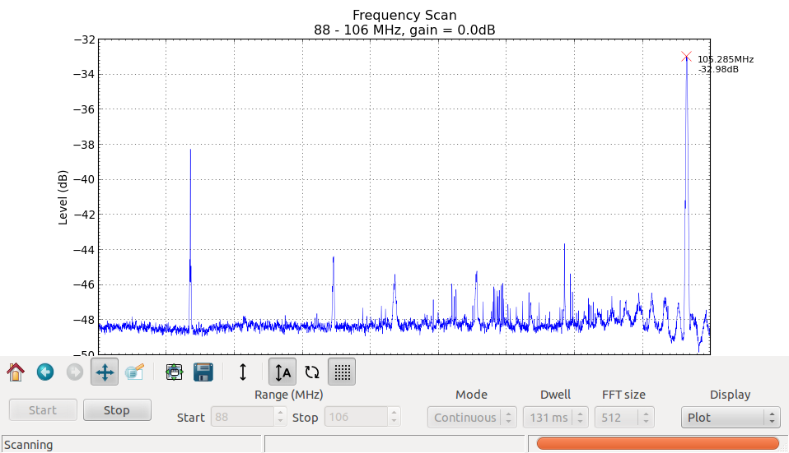
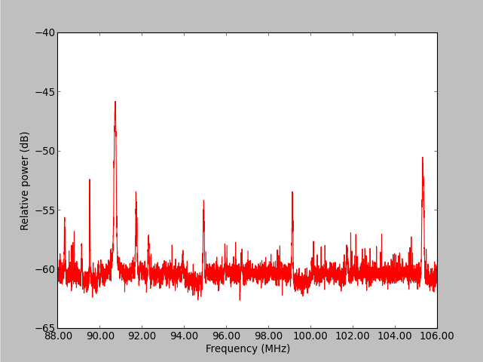
Micronet: Spectrum Sensing
RTLSDR Scanner
RTLSDR Spectrum Sense

Slide 11
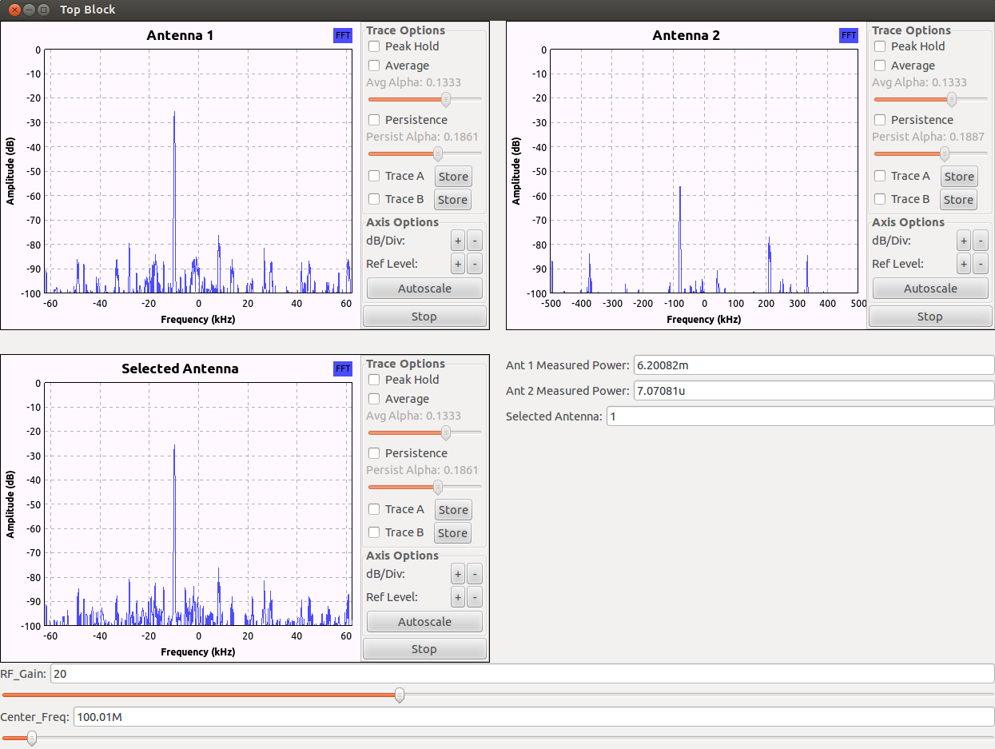
Micronet: Antenna Selection Diversity

Slide 12
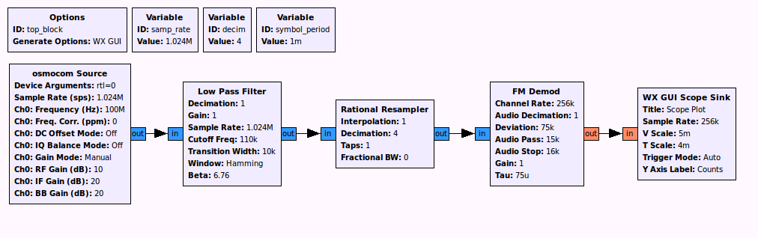
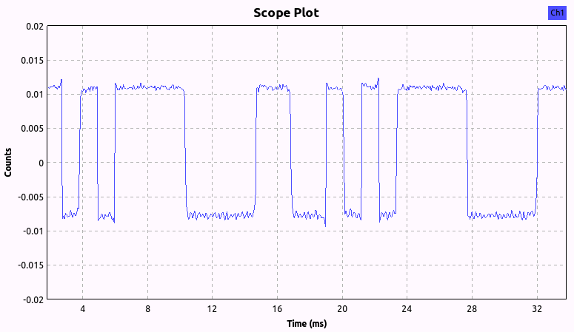
Micronet: FSK Tx/Rx

Slide 13
Micronet: Basic DSA
Procedure
Scan allowable transmit frequency range
Determine optimal transmit channel based on channel power and adjacent channel powers
Transmit a single burst
Recheck vacancy of channel

Slide 14
Micronet: Additional Plans
Experiments
SDR position estimation
Antenna diversity
Phased antenna arrays
Basic DSA algorithms
CR coexistence with CORNET
Development
Raspberry Pi Transmission
Integration with SDR tools
Optimization/Measurement of performance (BER)
Demo’s/applications
Hardware augmentation

Slide 15
Conclusion
What has been achieved/demonstrated
Creation of a CR testbed that is:
Low cost
Flexible/portable
Supports multiple radio nodes
Has the potential for many diverse experiments
Identified limitations
Processing power
Bandwidth
Tx capabilities
Limited modulation schemes
Lack of power control
Spurious signal

